Slide 1
dGen: Distributed Wind Model Assumptions
Presentation to DOE Wind Program
Ian-Baring Gould, Ben Sigrin, Robert Preus, Eric Lantz, and Mike Gleason
November 15, 2015

Slide 2
Presentation Objective
Review major algorithms and dGen model input variables
Finalize case studies
Identify topics for expanded discussion of model assumptions
Discuss additional industry members to add to the technical review committee

Slide 3
Presentation Overview
Review key model dynamics
Review core algorithms for modeling diffusion of technology
Summary of major input data assumptions
Wind-specific and tech agnostic
Detailed review of each major assumption
Default settings
Basis for settings
Known areas for improvement
Planned future work (Q1-Q2)

Slide 4
Key Model Dynamics (Part 1)
Models the deployment of distributed wind for behind-the-meter customers only
Includes: individual households and businesses making independent investment choice for an on-site wind system
Excludes: community wind, wind gardens, utility wind, virtual net-metering
Relationship to REEDS
REEDS models capacity expansion of utility (wholesale) wind generation
dGen models behind-the-meter applications only, based an individual customer’s load
Neither dGen nor REEDS accounts for community based wind that might be higher cost (not included in ReEDS) but also not behind the meter (dGen)
Does reduce overall wholesale energy demand, a portion of which would come from wind
Linkage w/ ReEDS developed for solar, and extendable for wind
Competition between technologies:
The solar and wind markets are generally modeled in isolation, which assumes no competition
We recently added a feature to facilitate modeling of competition, but have not tested it thoroughly
Notes:
This is a good point to stop and ensure that DOE has no other questions about basic model dynamics.

Slide 5
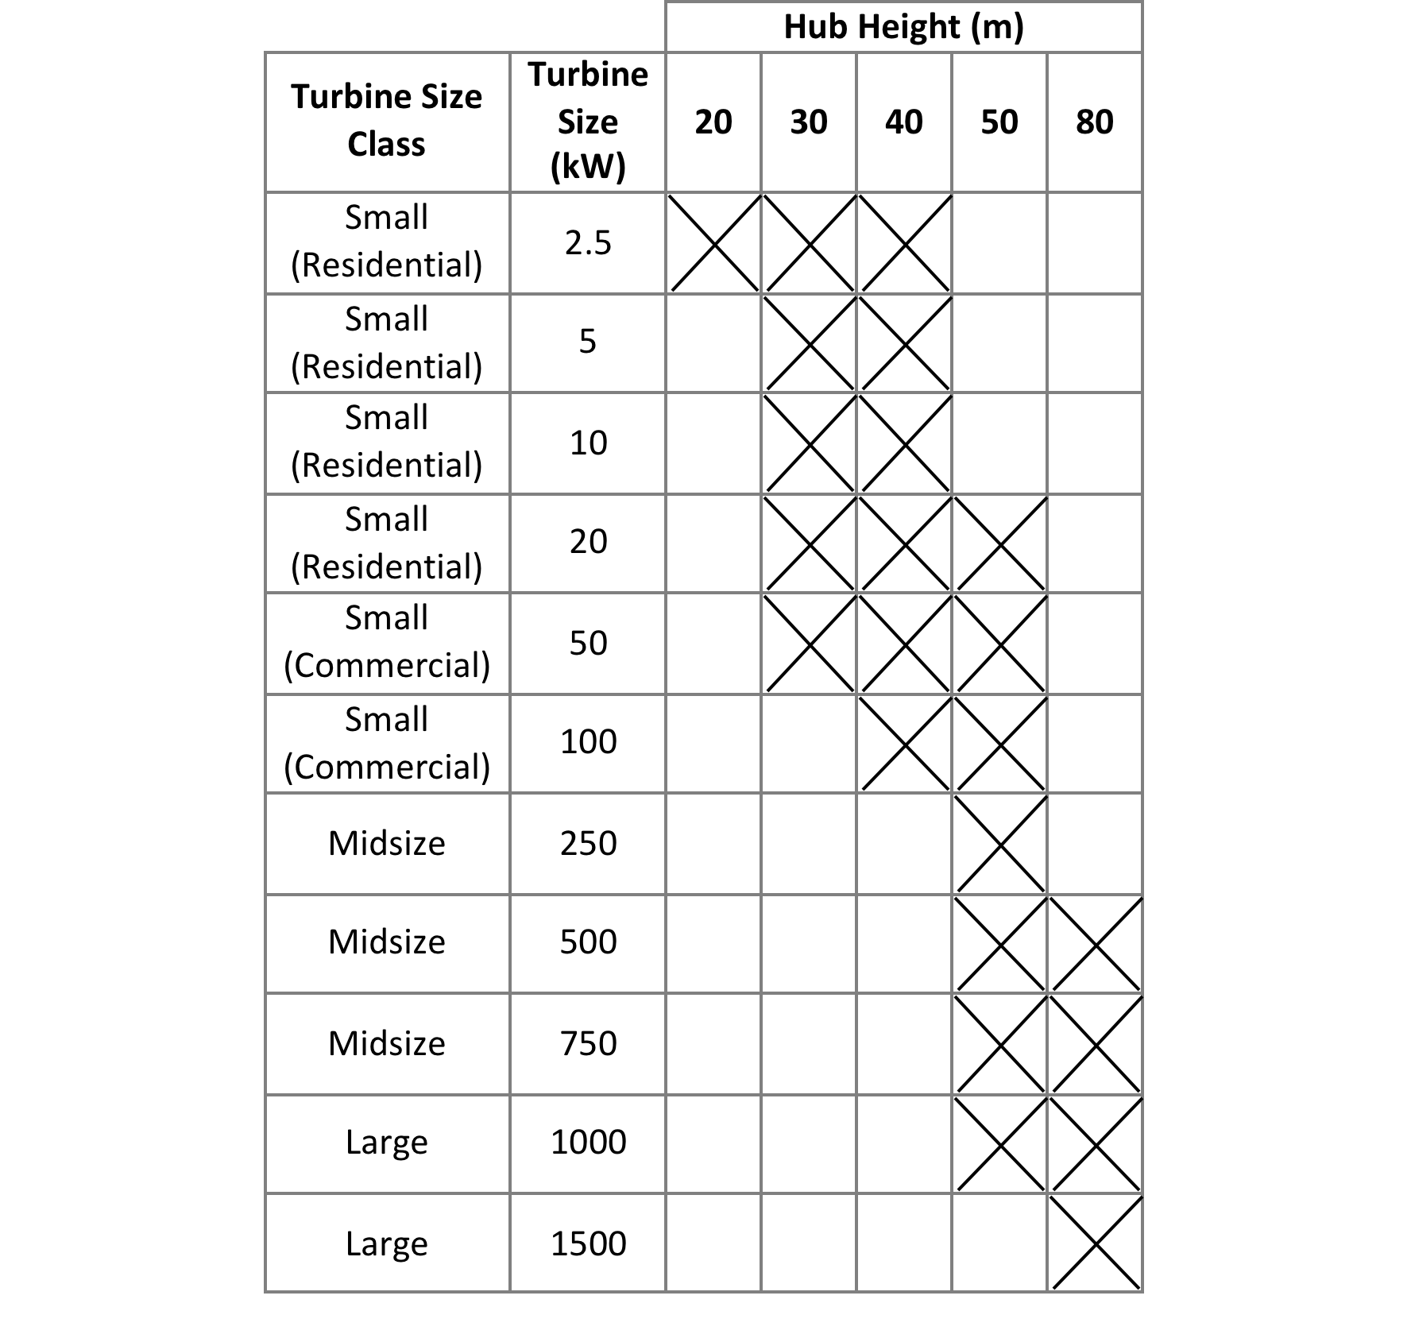
Key Model Dynamics (Part 2)
System sizes:
Turbine sizes range from 2.5 kW to 1.5 MW, with hub heights from 20 to 80 m
For heavy industrial users, multiple 1.5 MW turbines may be installed
Notes:
This is a good point to stop and ensure that DOE has no other questions about basic model dynamics.

Slide 6
Overview of Modeling Approach
Initiate a set of statistically representative customer agents that are imbued with characteristics (consumption, location, rates, incentives, etc.)
For each 2-year increment:
Apply technical and siting restrictions, to determine system sizing and resource quality
Determine net value of DW for eligible customers based on discounted cash flow analysis project costs and benefits
Model deployment of technology using Bass diffusion, where economics define the maximum market size and rate of adoption

Slide 7
dGen Core Model Algorithms
Populate the model with agents (potential customers) based on high-resolution geospatial database
Review agents for system siting (hub height) constraints
Viable agents then are provided a viable DW system size based on annual electricity consumption and local net metering policy
Wind resource is identified at each agent location
Bill savings calculated for each agent based on wind resource, electricity load, and retail rates
Cash flow analysis completed for each agent
Business model selected (host owned or leased)
Total potential market calculated based on customer economics
Diffusion theory used to determine how much of the potential market will adopt annually

Slide 8
Core Model Algorithms: Modeling Diffusion
Economic scale the overall long-term potential market size (“maximum market share”)
Economics are translated to maximum market share using adoption curves
Adoption curves are based on technology-agnostic literature
Adoption curves reflect that some people will adopt at poor economics, and not everyone will adopt at excellent economics
Changes in economic conditions expand or limit long term market potential
Time

Slide 9
dWind Input Parameters
Includes data on:
Wind resource and surface cover
Coincident hourly patterns of generation and consumption
Utility electricity rates structures
Allows the manipulation of:
Deployed price and how it changes over time
Turbine performance and how it changes over time
Federal, state, and local policies: incentives and net energy metering
Escalations in electricity rates over time
Growth in load over time
Adoption (max market share) curves
Financial terms (including leasing terms, by sector and over time)
A more detailed review of input parameters is planned.

Slide 10
Model Case Studies

Slide 11
Model Cases
Propose to conduct a bracket analysis using four simulation cases:
Best case: Most favorable DW development
Most likely case: Assume that DW can develop in a way similar to larger wind and solar markets
Business as usual case: Development is more reserved
Worst case: No real market changes
There will not be changes to the model for the different cases – only changes to the model inputs

Slide 12
Model Assumptions

Slide 13
Summary of Wind-Specific Model Assumptions
Assumption | Level of Support | Basis of Support
Turbine Performance (Current) | High | Empirical + Engineering Judgment + Analysis
Turbine Performance (Future) | High | Engineering Judgment
Turbine Performance Improvement Schedule | Low | Empirical + Analysis
Installation Costs (Current) | Medium | Empirical + Engineering Judgment
Installation Costs (Future) | Low | Empirical + Analysis
O&M Costs (Current) | Medium | Engineering Judgment
O&M Costs (Future) | Low | Empirical + Engineering Judgment
Financing | High | Empirical
Incentives | Low | Empirical + Analysis
[All] Do we want to include future projections in this presentation given the state they are currently in?
Notes:
Note:
Empirical = based on data
Empirical + Analysis = based on NREL analysis of empirical data
Engineering Judgment = based on logical decisions made by NREL on the basis of domain expertise and/or research

Slide 14
Summary of Model Assumptions (Tech Agnostic)
Assumption | Level of Support | Basis of Support
Electricity Rates and Rate Escalations | High | Empirical + Analysis
Net Metering | High | Empirical
Maximum Market Share Curves | High | Empirical
Load Growth | High | Empirical
Notes:
Note:
Empirical = based on data
Empirical + Analysis = based on NREL analysis of empirical data
Engineering Judgment = based on logical decisions made by NREL on the basis of domain expertise and/or research

Slide 15
Wind Turbine Performance

Slide 16
Turbine Performance Improvement Schedule (Future)
Overview:
8 preset turbine power curves used in the model
One of 8 power curves is assigned to each turbine size for each model year
Basis of Support:
The rate through which technology improvement occurs has limited scientific backing.
Planned Future Work:
Improvement schedule will vary for the four case studies, based on consensus between DOE and NREL, with TRC review
ID | Power Curve
1 | Current Small Residential-Scale Turbine
2 | Current Small Commercial-Scale Turbine
3 | Current Mid-Size Turbine
4 | Current Large Turbine
5 | Near Future Small Residential-Scale Turbine
6 | Far Future Small Residential-Scale Turbine
7 | Small, Mid-Size, and Large Near Future Turbine
8 | Small, Mid-Size, and Large Far Future Turbine
Turbine Size (kw) | 2014 | 2016 | 2018 | 2020 | 2022 | 2024 | 2026 | 2028 | 2030 | 2032 | 2034 | 2036 | 2038 | 2040 | 2042 | 2044 | 2046 | 2048 | 2050
2.5 | 1 | 1 | 5 | 5 | 5 | 6 | 6 | 6 | 6 | 6 | 6 | 6 | 6 | 6 | 6 | 6 | 6 | 6 | 6
5 | 1 | 1 | 5 | 5 | 5 | 6 | 6 | 6 | 6 | 6 | 6 | 6 | 6 | 6 | 6 | 6 | 6 | 6 | 6
10 | 1 | 1 | 5 | 5 | 5 | 6 | 6 | 6 | 6 | 6 | 6 | 6 | 6 | 6 | 6 | 6 | 6 | 6 | 6
20 | 1 | 1 | 5 | 5 | 5 | 6 | 6 | 6 | 6 | 6 | 6 | 6 | 6 | 6 | 6 | 6 | 6 | 6 | 6
50 | 2 | 2 | 2 | 7 | 7 | 7 | 7 | 8 | 8 | 8 | 8 | 8 | 8 | 8 | 8 | 8 | 8 | 8 | 8
100 | 2 | 2 | 2 | 7 | 7 | 7 | 7 | 8 | 8 | 8 | 8 | 8 | 8 | 8 | 8 | 8 | 8 | 8 | 8
250 | 3 | 3 | 7 | 7 | 7 | 7 | 7 | 7 | 8 | 8 | 8 | 8 | 8 | 8 | 8 | 8 | 8 | 8 | 8
500 | 3 | 3 | 7 | 7 | 7 | 7 | 7 | 7 | 8 | 8 | 8 | 8 | 8 | 8 | 8 | 8 | 8 | 8 | 8
750 | 3 | 3 | 7 | 7 | 7 | 7 | 7 | 7 | 8 | 8 | 8 | 8 | 8 | 8 | 8 | 8 | 8 | 8 | 8
1000 | 3 | 3 | 3 | 7 | 7 | 7 | 7 | 7 | 8 | 8 | 8 | 8 | 8 | 8 | 8 | 8 | 8 | 8 | 8
1500 | 4 | 4 | 4 | 4 | 8 | 8 | 8 | 8 | 8 | 8 | 8 | 8 | 8 | 8 | 8 | 8 | 8 | 8 | 8

Slide 17
Turbine Performance (Current)
Overview:
4 present power curves representing current turbines
Basis of Support:
Current industry data for turbines 2.5 to 1500 kW, including discussions with industry contacts on current models
Normalized power curves by rated power, constructed generic representative power curves with equal swept area and normalized annual energy
Planned Future Work:
Review by TRC
Default Settings:
Power Curve | Rotor Efficiency (m²/kWp) | Capacity Factor | Power Curve ID
Current Small Residential (2.5‑20 kw) | 3.07 | 0.29 | 1
Current Small Commercial (50‑100 kw) | 4.9 | 0.375 | 2
Current Midsize (250‑1000 kw) | 3.1 | 0.42 | 3
Current Large (1500 kw) | 4.9 | 0.385 | 4

Slide 18
Turbine Performance (Future)
Overview:
Remaining 4 power curves represent possible near future and far future turbines
Basis of Support:
The Reference turbine for the Wind Vision anchors performance for large wind turbine
All other turbine sizes converge on this specific power over time based on maturity of existing technology at different size classes and technical/mechanical factors limiting future improvements
Planned Future Work:
Review by TRC
Default Settings:
Power Curve | Rotor Efficiency (m²/kWp) | Capacity Factor | Power Curve ID
Near Future Small Residential (2.5‑20 kw) | 4.0 | 0.385 | 5
Far Future Small Residential (2.5‑20 kw) | 5.2 | 0.40 | 6
Near Future Small Commercial to Large (50-1500 kw) | 4.2 | 0.43 | 7
Large (1500 kw) | 5.2 | 0.44 | 8

Slide 19
All Power Turbine Curves

Slide 20
Wind Turbine Costs

Slide 21
Installation Costs (Current)
Overview:
Two inputs for costs:
Baseline capital costs ($/kW) based on default tower height
Marginal costs for taller towers above default height
Basis of Support:
Reviewed project cost information from US Dept. of Treasury 1603 dataset
Discussions with turbine manufacturers, wind developers, and tower suppliers
Determined median costs for systems at various heights and for marginal tower height costs
Areas for Improvement:
Sparse data available for marginal tower costs for mid-size (250-750 kW) turbines
Default Settings:
Turbine Rated Power (kW) | Baseline Capital Cost ($/kW) | Full Cost ($) | Default Turbine Height (m) | Marginal Tower Cost ($/kW*m)
2.5 | $10,045 | $25,113 | 20 | $211
5 | $7,785 | $38,925 | 30 | $164
10 | $6,914 | $69,145 | 30 | $118
20 | $6,459 | $129,186 | 30 | $71
50 | $5,858 | $292,879 | 30 | $15.70
100 | $5,402 | $540,238 | 40 | $11.30
250 | $3,525 | $881,232 | 50 | $10.80
500 | $2,961 | $1,480,283 | 50 | $9.90
750 | $2,630 | $1,972,827 | 50 | $9.00
1,000 | $2,396 | $2,396,206 | 80 | $8.10
1,500 | $2,185 | $3,277,628 | 80 | $6.40
Planned Future Work:
Additional research into tower costs for 250-750 kw turbines
Review by TRC

Slide 22
Installation Costs (Future)
Overview:
Input costs for each turbine size and model year
Basis of Support:
Costs reduced over time for each turbine size
The Reference turbine for the Wind Vision anchors cost for the large wind turbine with others maintaining current cost ratio through 2050
Maintain principle that larger turbines will be inherently less expensive.
Areas for Improvement:
Additional empirical support for short-term projections (through 2020)
Long-term projections under different scenarios
Planned Future Work:
Perform additional research/interviews with industry contacts
Evaluate other cost curve projection approaches such as Learning Curve
Develop internal consensus on schedules for four scenarios

Slide 23
O&M Costs (Current)
Overview:
Two inputs:
Scheduled maintenance
Unscheduled maintenance
Basis of Support:
Scheduled costs based on discussions with industry and turbine lessors; validated with maintenance manuals
Unscheduled costs are harder to assess for DW: data taken from discussions with lease companies on their assumptions for future maintenance costs
Fit linear regression to collected data to estimate O&M costs for 11 turbine sizes in model
Areas for Improvement:
Unscheduled maintenance at size extremes (<10 kW and >750 kW)
Additional data points for all sizes
Default Settings:
Turbine Rating (kW) | Scheduled O&M ($/kW) | Unscheduled O&M ($/kW) | Total Fixed O&M ($/kW)
2.5 | 27.64 | 11.3 | $38.94
5 | 27.62 | 11.3 | $38.92
10 | 27.58 | 11.3 | 38.88
20 | 27.5 | 11.3 | 38.8
50 | 27.27 | 11.29 | 38.56
100 | 26.87 | 11.28 | 38.15
250 | 25.69 | 11.25 | 36.94
500 | 23.71 | 11.2 | 34.91
750 | 21.74 | 11.15 | $32.89
1000 | 19.76 | 11.1 | $30.86
1500 | 15.81 | 11 | $26.81
Planned Future Work:
Additional data collection/interviews
If sufficient data available, fit separate regressions for 2.5-50 kW and 50-1500 kW
Review by TRC

Slide 24
O&M Costs (Future)
Overview:
O&M costs for each turbine size are specified for each model year
Basis of Support:
Very limited empirical support
Areas for Improvement:
Short and long-term projections under different scenarios
Planned Future Work:
Additional research/interview with industry
Develop internal consensus on cost schedules for four scenarios
Review by TRC

Slide 25
Financing (Current)
Overview:
Financing parameter specified separately for lease vs. owned systems and res/com/ind sectors
Assumes all customers have access to financing
Basis of Support:
Financing costs for host-owned systems based on opportunity cost of capital based on public debt and home equity loans
Leased system costs based on lessor hurdle rates from Davidson et al. (2015)
Areas for Improvement:
Lessor hurdle rates are based on historical rates for solar leasing companies for the residential sector
Default Settings:
Res Host-Owned: 20 yr loan, 20% down, 5% APR (current 20-yr home equity loan)
Non-Res Host-Owned: 20 yr loan, 40% down, 5.25% APR (current 20-yr AA corporate bond)
Res TPO: 20 yr lease, 0% down, 0% escalation, lessor rate of return of 7% (Davidson et al. 2015)
Non-Res TPO: 20 yr lease, 0% down, 0% escalation, lessor rate of return of 7% (Davidson et al. 2015)
Planned Future Work:
Additional data collection from current wind lessors and developers on typical financing terms
Add feature to allow different financing terms over time
Review by TRC

Slide 26
Financing (Future)
Overview:
Model will allow for changing financing parameters over time
Possible Basis of Support:
Compare to distributed solar market development and financing history (assuming data are available)
Evaluate existing historical rates (bonds, home equity) and/or long-term projections of other financial assets to bound scenarios
Planned Future Work
Develop internal consensus on methodology and actual values for financing parameters for four scenarios
Review by TRC

Slide 27
Incentives (Federal) – Current and Future
Overview:
Federal ITC level can be specified by market sector and model year
Basis of Support:
Assume continuation of existing ITC policy under business-as-usual
Planned Future Work
Develop consensus on ITC settings for four scenarios
Review by TRC
Default Settings:
Year | Residential | Commercial | Industrial
2014 | 30% | 30% | 30%
2016 | 30% | 30% | 30%
2018 | 0% | 10% | 10%
2020 | 0% | 10% | 10%
2022 | 0% | 10% | 10%
2024 | 0% | 10% | 10%
2026 | 0% | 10% | 10%
2028 | 0% | 10% | 10%
2030 | 0% | 10% | 10%
2032 | 0% | 10% | 10%
2034 | 0% | 10% | 10%
2036 | 0% | 10% | 10%
2038 | 0% | 10% | 10%
2040 | 0% | 10% | 10%
2042 | 0% | 10% | 10%
2044 | 0% | 10% | 10%
2046 | 0% | 10% | 10%
2048 | 0% | 10% | 10%
2050 | 0% | 10% | 10%

Slide 28
Incentives (State and Local) – Current and Future
Overview:
State and local incentives can either be sourced from DSIRE database or user-defined inputs
Basis of Support:
DSIRE database is used as the default source for state and local incentives
Areas of Improvement:
DSIRE data has not been updated since 2013 and is missing key information (e.g., expiration dates)
Planned Future Work
Replace/update DSIRE data with policy data from PNNL
Develop consensus on default state policy incentive expirations for four scenarios
Review by TRC

Slide 29
Detailed Model Assumptions: Technology-Agnostic

Slide 30
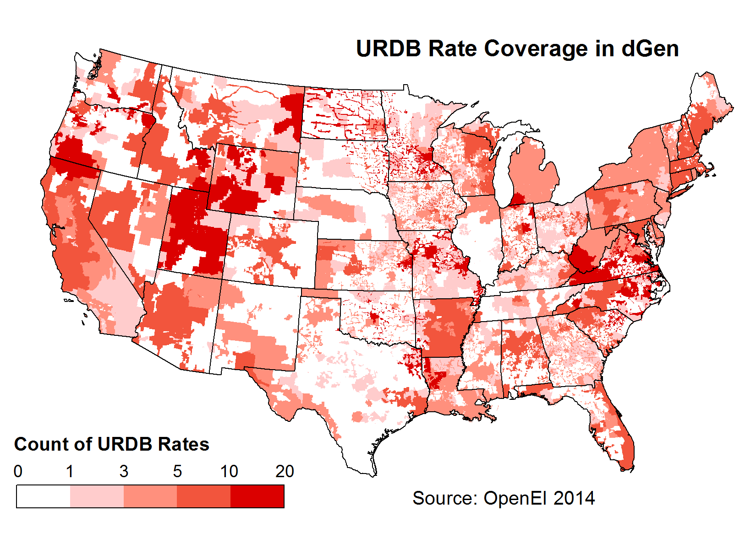
Electricity Rates (Current)
Overview:
Retail rates are based on real-world tariffs extracted from OpenEI Utility Rate Database (URDB)
Basis of Support:
Real-world tariffs from the URDB closely resemble the current electricity costs incurred by electricity consumers in the US
Planned Future Work
Review by TRC

Slide 31
Electricity Rates (Future)
Overview:
Future retail rates are based on AEO2015 regional escalation forecasts
Alternative future rate structures may be evaluated, but current structures are used by default
Basis of Support:
AEO 2014 & 2015 Reference Case projections provide rate escalations through 2040; rates are either constant in real terms or extrapolated thereafter
Planned Future Work
Review by TRC
Default Settings:
AEO 2015 (rate escalations in real terms ($2014) thorugh 2040, constant in real terms 2040-2070)
Alternative Settings:
AEO2015 + Extrapolation 2040+
AEO 2014
No growth
User defined

Slide 32
Net Energy Metering Policies (Current and Future)
Overview:
Net Energy Metering (NEM) outflow credit valuation and maximum system size can be set by state and sector
NEM expiration years can also be set by state
Basis of Support/Default Setting:
Default NEM maximum system sizes by state and sector are based on current policy (Barnes et al. 2013).
Non-NEM outflow credit valuation is based on projected wholesale electricity rates by state and model year using the ReEDS ATB Central Scenario
Default NEM expiration years by state are based comparison of a recent dGen BAU run for the solar market against cumulative state NEM limits from Barnes et al. (2013)
Planned Future Work:
Potential update of NEM expiration years based on future updated solar BAU scenario run
Review by TRC

Slide 33
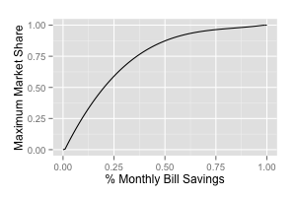
Maximum Market Share Curves
Overview:
Adoption or Maximum market share (MMS) curves relate economic attractiveness to long-term market potential
The model includes several options for MMS curves
Basis of Support:
We use curves from Paidipati et al. (2008) and Sigrin and Drury (2015) for host-owned systems for consistency with previous research (SunShot Vision Study) and because they are mid-line estimates compared to other options
We use the only available curve for leased systems, which is based on surveys of the residential solar market
Planned Future Work:
May update leasing MMS curve using more recent solar data
Review by TRC
Default Settings:
Host-Owned
Leased

Slide 34
Load Growth Projections (Future)
Overview:
Load growth is implemented in the model as population growth in each sector
10 load growth scenarios are available, all from AEO 2014 and 2015
Basis of Support:
AEO 2014 & 2015 Reference Case projections provide 5 different scenarios each.
We use AEO 2015 (Reference Case) as the default because it is the most up-to-date, business-as-usual case available from AEO
Planned Future Work
Review by TRC

Slide 35
Model Algorithms

Slide 36
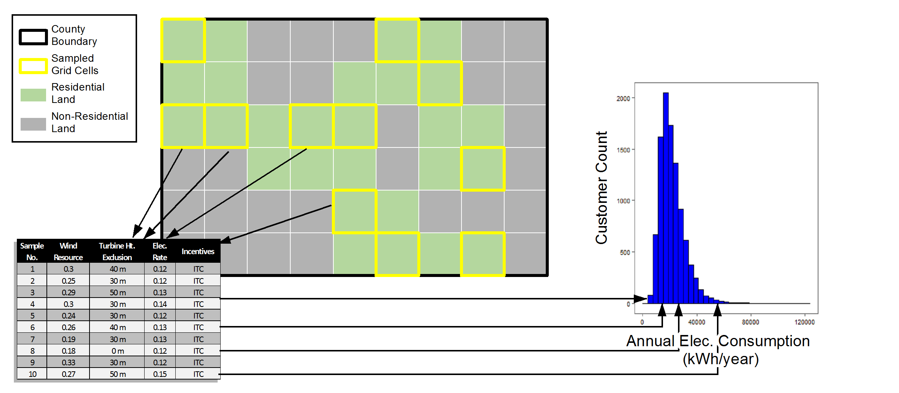
Statistical Representation of Customers
To reconcile data sets of disparate resolutions, we represent customers through a statistical framework
1) Sample points in county. Each point represents a customer. There may be more than 1 per cell.
3) Randomly associate customer segments with national distributions, such as customer load patterns
2) Associate with exclusions, CF, rates, etc.

Slide 37
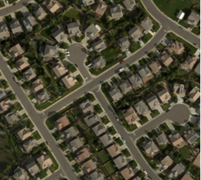
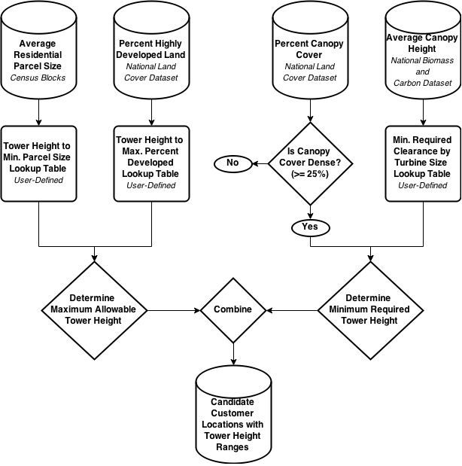
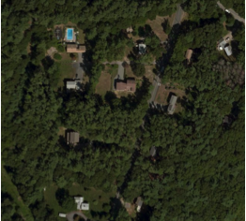
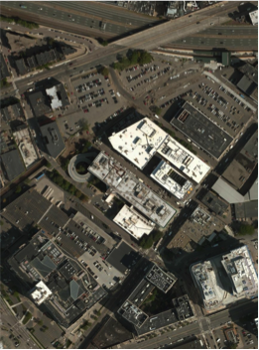
Turbine Siting Criteria
Parcel Size
TREE COVER
AND HEIGHT
HIGHLY DEVELOPED,
LAND

Slide 38
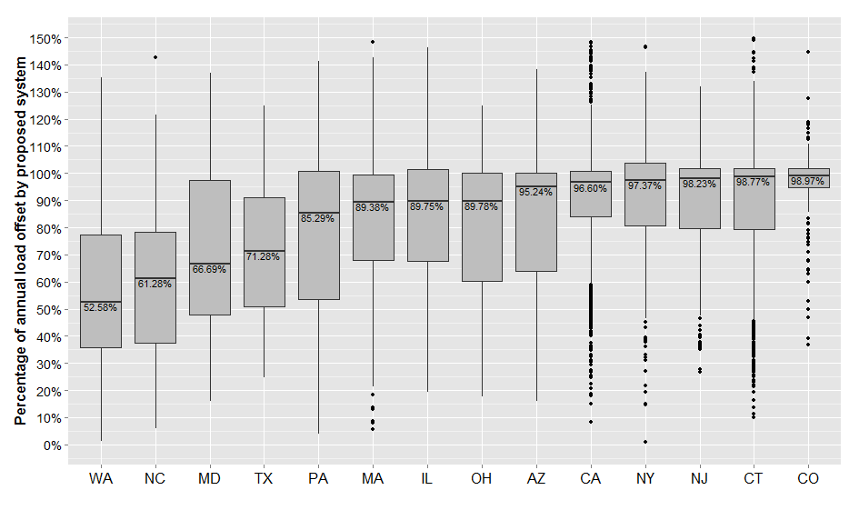
Agent System Sizing
The prospective wind system is sized to meet a user-defined percentage of annual electricity consumption
Sizing targets vary for customers with and without net-metering
Sizing of Distributed Solar Systems from Actual Quote Data
Source: Davidson et al. (2015)

Slide 39
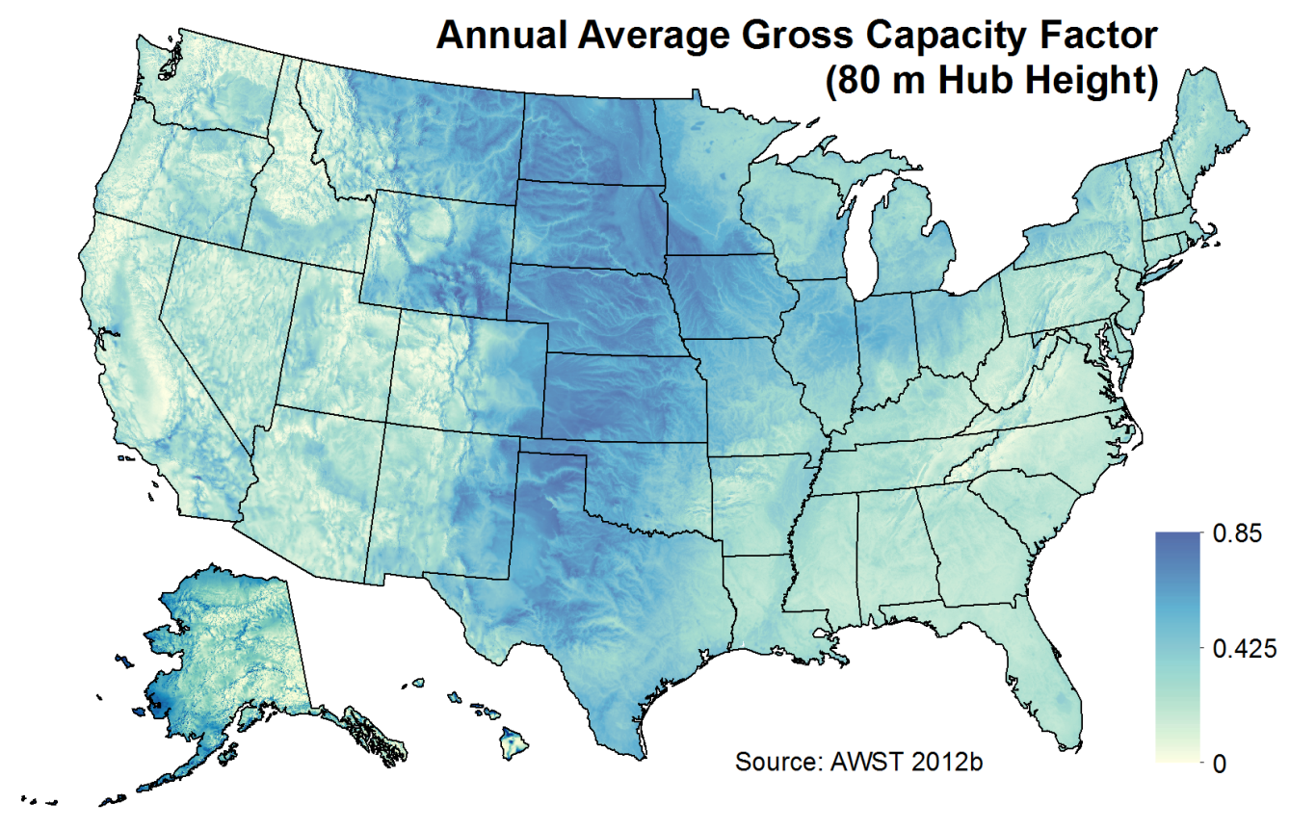
Wind Resource
Wind resource is derived from a gridded dataset of hourly wind speed data, licensed by NREL from AWS TruePower and consist of hourly average wind speeds for the “typical meteorological year” (TMY) at each location (AWST 2012a).
These TMY hourly profiles represent typical historical conditions at each grid cell based on 14 years of historical wind speed data (AWST 2012c).
A tool developed by domain experts at the NWTC is used to convert wind speeds to hourly kWh generation, based on WTG power curves
Resource data is resolved in the model at 200m level for hub heights of 20, 30, 40, 50, & 80m

Slide 40
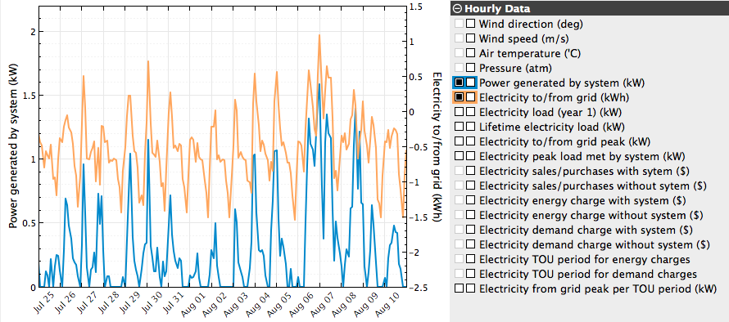
Calculation of Bill Savings
Bill savings are calculated using the System Advisory Model (SAM) based on each agent’s:
Regional Rate Tariff
Hourly Electricity Consumption
Hourly Wind Generation
Notes:
Current generic curves are based on a representative currently available turbine. Ration of area to rating used and efficiency adjusted till AEP matched turbine selected at 5.5 m/s. Power level capped at rating.

Slide 41
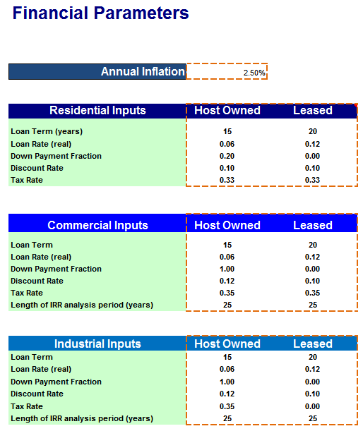
Cash Flow Analysis
Discounted cash flow calculation is used to determine economic attractiveness based on:
System costs
Revenue from bill savings
Revenue from incentives
Revenue from tax deductions (depreciation, loan interest, etc.)
High level of customization of financing terms
Systems can be host-owned (buy) or third party-owned (lease)
Produces outputs including:
Payback period
Internal rate of return
Net Present Values

Slide 42

Selection of Business Model
Agents select from host-owned and third-party business models through a probabilistic comparison of the net present value (NPV) of both options
The probability of an agent selecting the leasing model (P_{L}) is defined using a standard logit equation:
where:
N_{L} = NPV of leasing
N_{B} = NPV of buying
α = segregation parameter with a default value = 2
In this formulation, the agent is indifferent to either model when both models provide equal economic benefits, but it is likely to prefer the business model with superior economics.

Slide 43
Summary of data sets used
Description | Source | Spatial Resolution
Resource Quality - Annual Energy Production | AWST 2012a, AWST 2012b, Dobos 2015, George et al. 2007, NSRDB 2015 | 200 m by 200 m
Potential Agent Locations | ORNL 2011, HSIP 2012 | 200 m by 200 m
Additional Technology-Dependent Siting Criteria (e.g., roof orientation, minimum and maximum turbine heights) | ORNL 2011, HSIP 2012, Gagnon et al. (2015) | 200 m by 200 m
Prevailing Retail Electricity Rates (2014) | OpenEI 2014 | Electric Utility Service Territories
Applicable Incentive Policies | DSIRE 2014 | Variable: Electric Service Territories, County, State, Nation
Existing Net-Metering Availability | Barnes et al. 2013 | State
Total Annual Electric Load by County | Ventyx 2012 | County
Total Count of Electric Customers by County | Ventyx 2012 | County
Microdata Representations of Customer-Level Electric Load | EIA 2008 | Census divisions (multistate regions)
Load Growth Projections | EIA 2015b | Census divisions (multistate regions)
Electricity Rate Projections | EIA 2015b | Nation
Financing Parameters | DOE 2012 | Nation

Slide 44
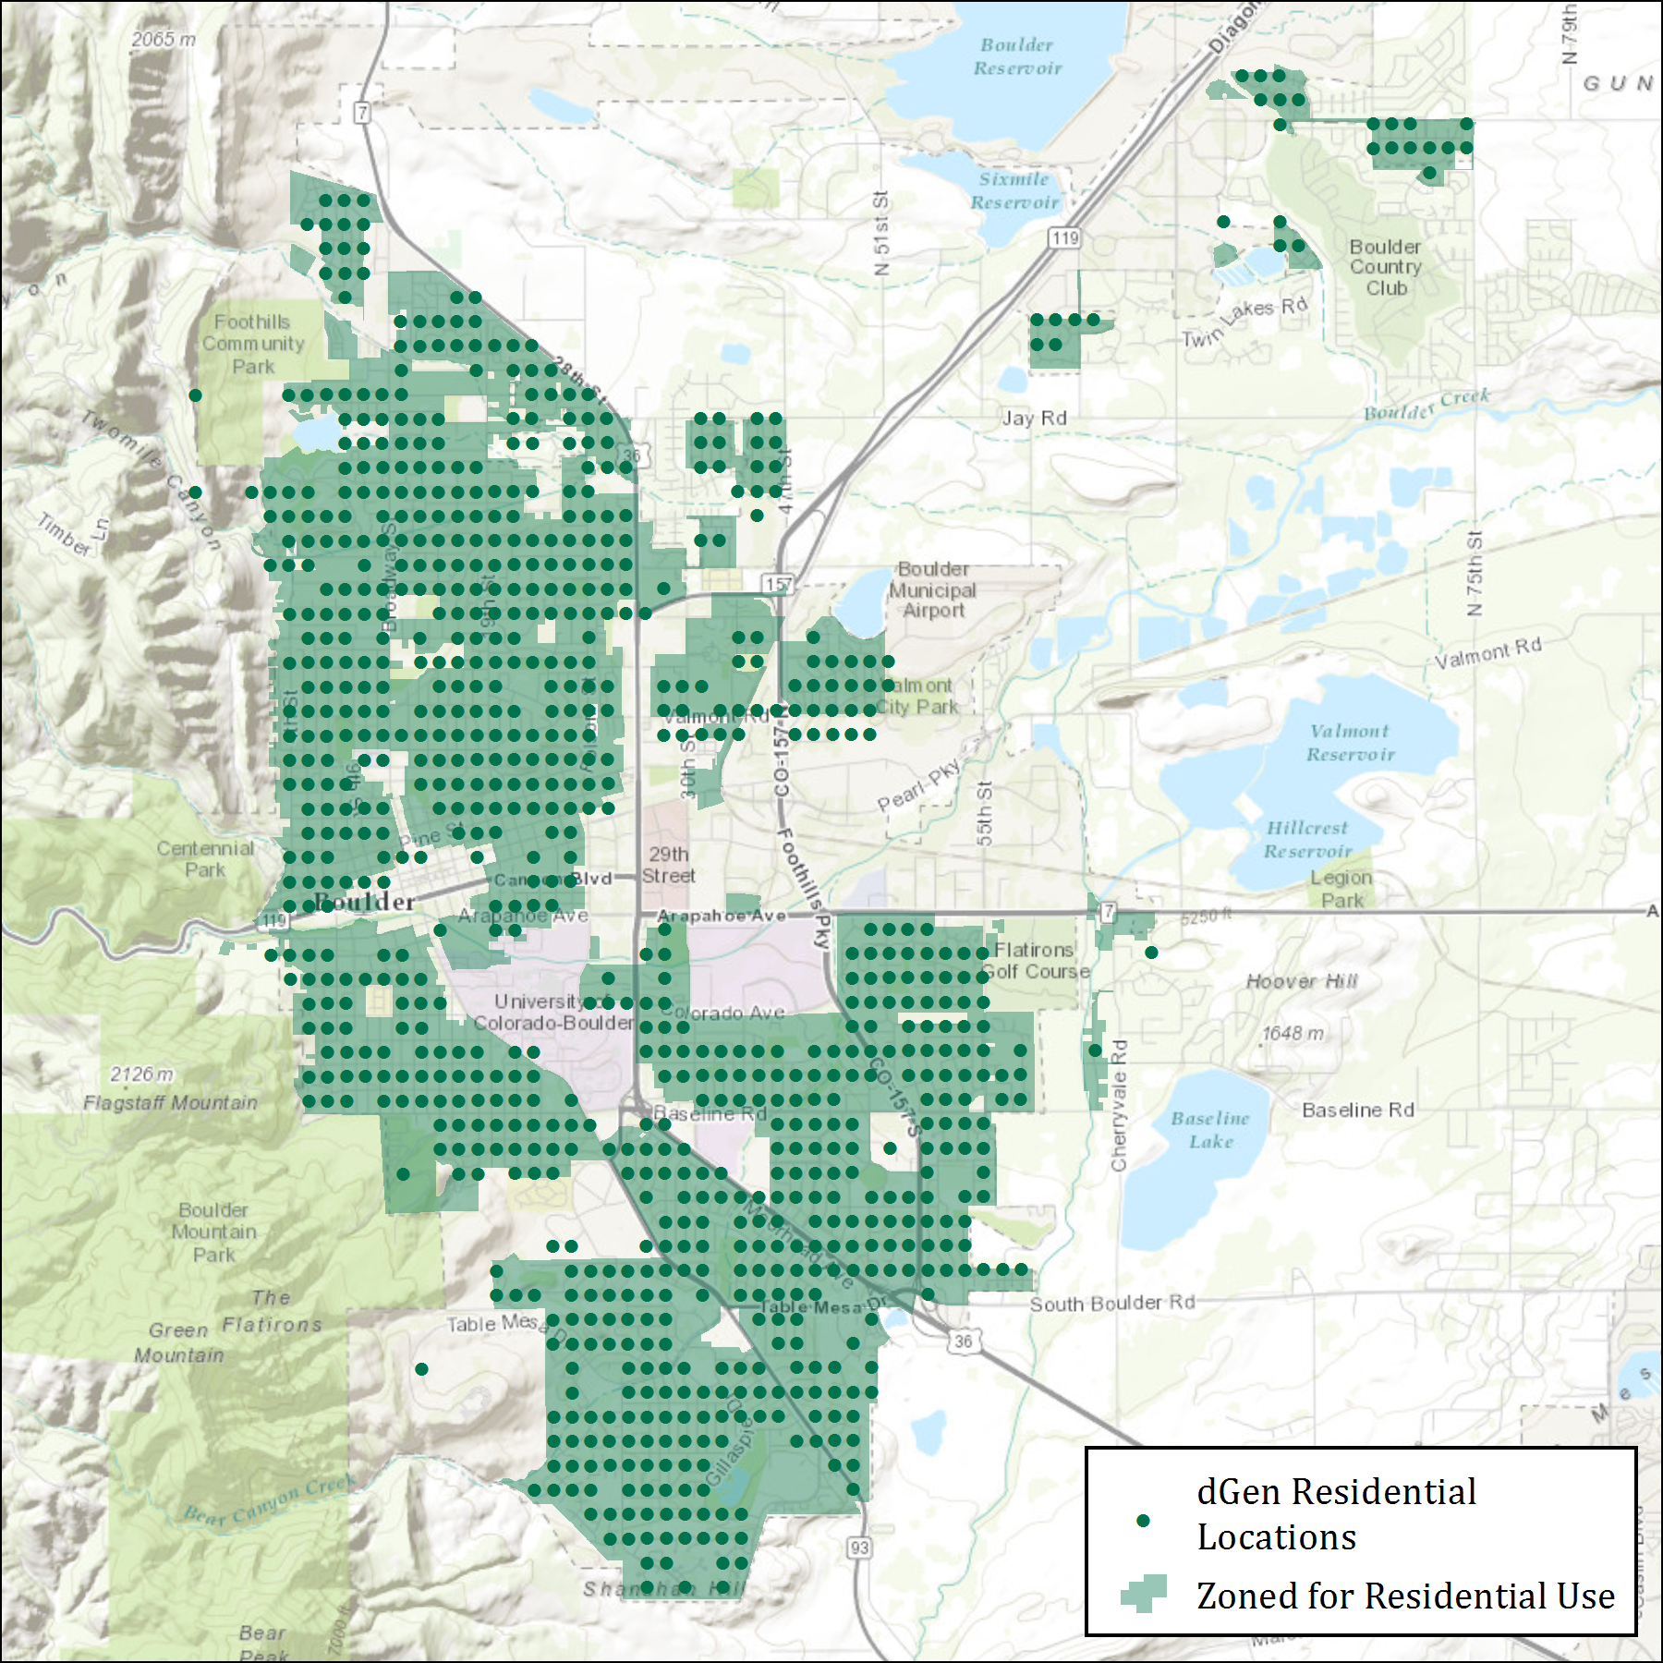
Geospatial Database Framework
dGen is supported by a highly resolved geospatial database that integrates several local and regional datasets
Some datasets are resolved down to 200 m by 200 m grid cells
Agent locations
Canopy height and cover
Building density
Wind resource

